Slide 1
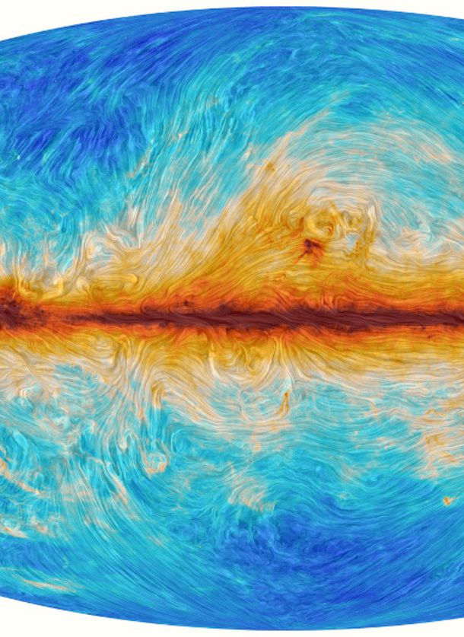
AST425 Project Presentation
WHAT LOCAL MAGNETIC FIELDS CAN TEACH US ABOUT A
POSSIBLE SUPERNOVA REMNANT (G182.5-4.0)
By: Parampreet Singh
The magnetic field of our Milky Way galaxy as seen by the Planck satellite. Credit: ESA and the Planck Collaboration.

Slide 2
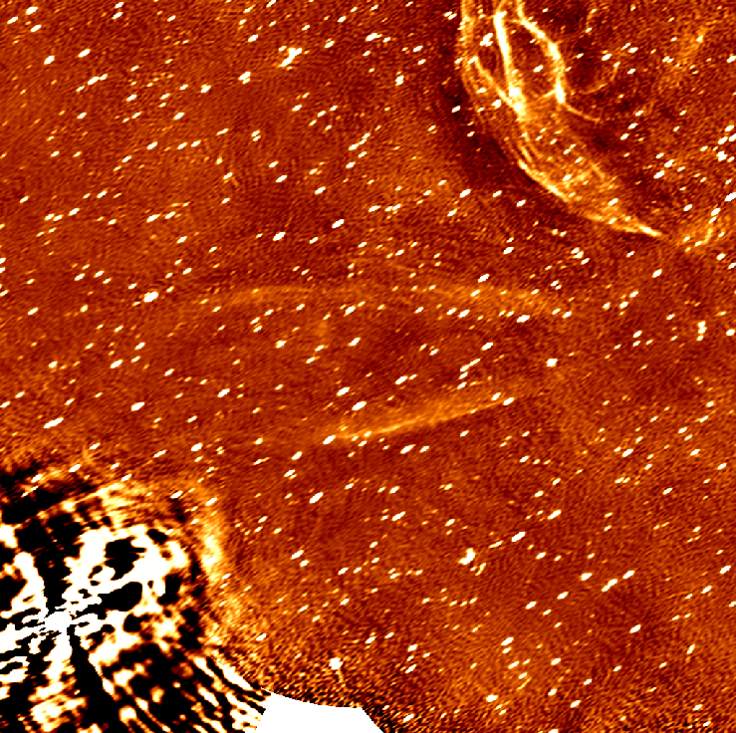
Motivation
G182.5-4.0 is a very unusual object (compressed, thin, and straight)
We would like to understand what this object is
We are interested in the magnetic field
G182.5-4.0 disagrees with commonly known supernova remnant (SNR) geometries
Two current hypothesis
G182.5-4.0 as seen through Stokes Total Intensity. Credit: West et al., 2019

Slide 3
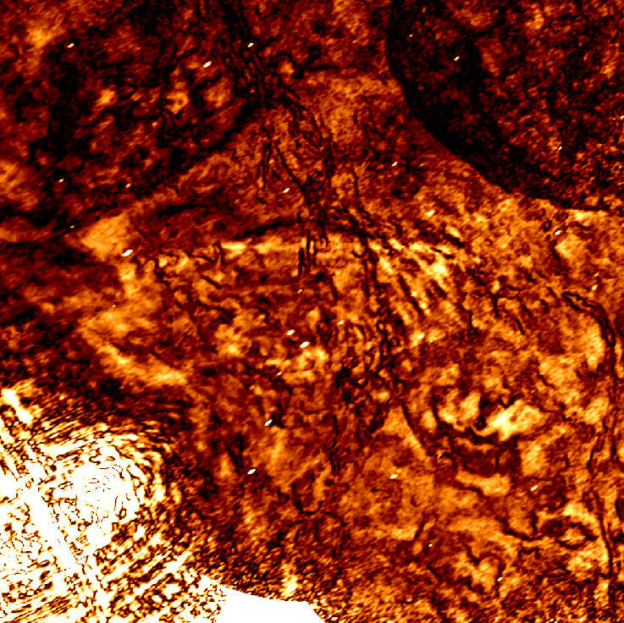
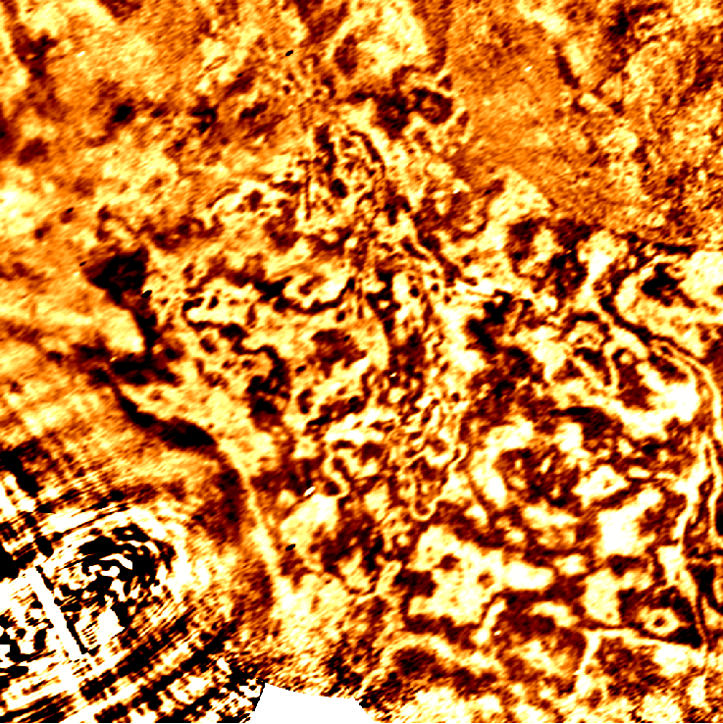
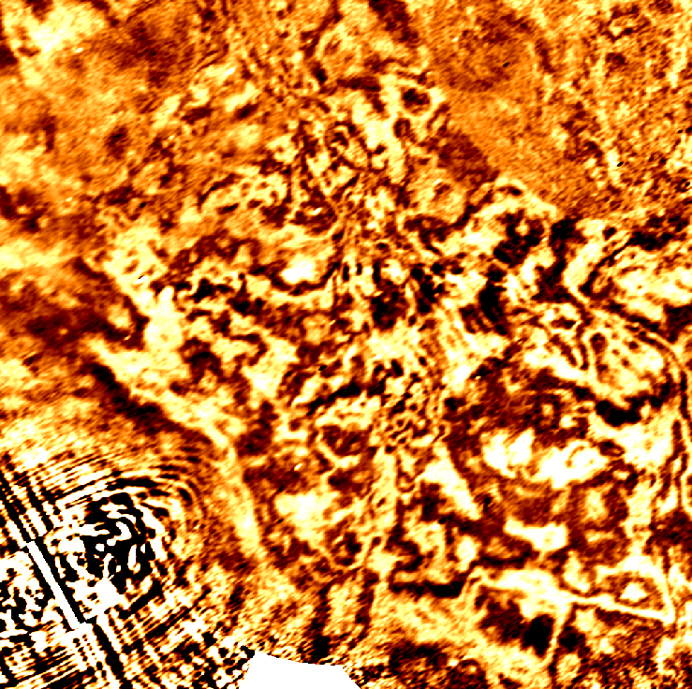
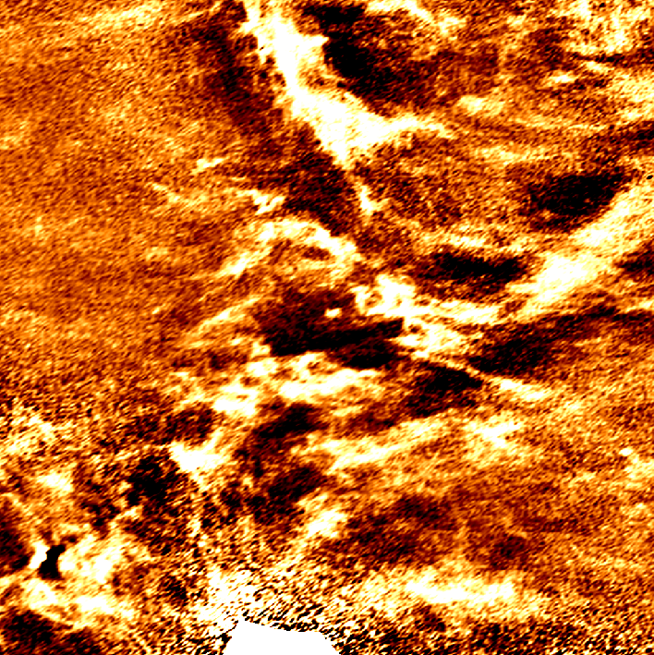
Research
Synchrotron Polarization
From DRAO-ST at a frequency of 1420MHz
Synchrotron Polarization Emission & HI Data from Dominion Radio Astrophysical Observatory Synthesis Telescope (DRAO-ST)
Connection between HI fibers & magnetic fields
The Rolling Hough Transform (RHT) and its application to HI fibers.
Stokes Total Intensity (I)
Stokes Polarized Intensity (PI)
Stokes Linear Polarized Component (U)
Stokes Linear Polarized Component (Q)
Image Credits: West et al., 2019
HI Data Slice

Slide 4
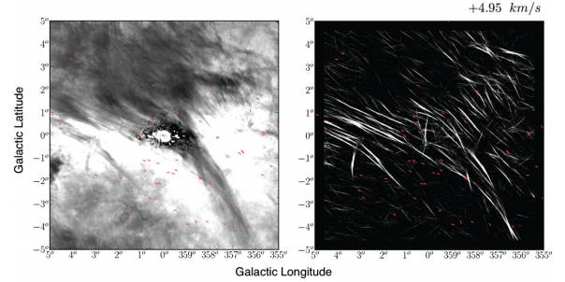
Research Cont.
Synchrotron Polarization Emission & HI Data from Dominion Radio Astrophysical Observatory Synthesis Telescope (DRAO-ST)
Connection between HI fibers & magnetic fields
The Rolling Hough Transform (RHT) and its application to HI fibers.
Riegel–Crutcher cloud in HI absorption (left) and RHT back projection (right)
Image Credits: Clark et al., 2014

Slide 5

Expected Outcomes
Magnetic field orientation through RHT
G182.5-4.0 filaments seem to trace the HI fibers
Figure out what G182.5-4.0 is!
Stokes Total Intensity (I)
HI Data Slice
Velocity: -14659 m/s
Image Credits: West et al., 2019

Slide 6

THANK
FOR LISTENING

